Slide 1
ADAPTIVE SOFTWARE ENGINEERING
AI-AcadPredict: AI-Based Academic Project Management and Delay Risk Prediction System
Team Members
BANDI SRIHITHA 2420030099
V. SAI DHANUSH 2420030162
R.L.S GIRIDHAR 2420030171
MAHALAKSHMI 2420030773
Under the Esteemed Guidance of
Dr .G . LAVANYA

Slide 2
Contents
Abstract
Introduction
Problem Statement
Objectives
Project Plan
Proposed Architecture and Methodology
Implementation
Results
Conclusion

Slide 3
ABSTRACT
AI-AcadPredict is an intelligent academic project management and delay prediction system designed to streamline project monitoring and evaluation.
Enables students to create, manage, and track academic projects.
Provides role-based dashboards for Students, Faculty, and Coordinators.
Facilitates project proposal submission, review, and approval.
Supports team collaboration, task management, and milestone tracking.
Integrates AI-based delay prediction using a Machine Learning model.
Provides centralized document management and project progress monitoring.
Key Outcome: Enhances academic project management through centralized collaboration, automated monitoring, and intelligent delay risk prediction.

Slide 4
INTRODUCTION
AI-AcadPredict is an AI-powered academic project management system developed to simplify the planning, execution, and monitoring of academic projects. It provides a centralized platform where students, faculty members, and coordinators can collaborate and manage project activities efficiently.
Helps students organize projects, manage teams, assign tasks, and track milestones.
Enables faculty members to guide students, review project proposals, and monitor project progress.
Allows coordinators to oversee academic projects, manage users, and track overall project activities.
Provides role-based dashboards to ensure each user has access to relevant features and information.
Integrates Artificial Intelligence and Machine Learning to analyze project details and predict the possibility of project delays.
Supports document management, progress tracking, and risk monitoring in one platform.
Improves communication, transparency, and coordination between students, faculty, and coordinators.
Overall, AI-AcadPredict aims to make academic project management more organized, collaborative, and proactive by combining project management tools with AI-based delay risk prediction.

Slide 5
PROBLEM STATEMENT
Problem Statement
Academic project management often relies on manual processes, making it difficult to track tasks, milestones, and project progress.Faculty members and coordinators face challenges in monitoring multiple projects efficiently.Existing methods provide limited support for identifying possible project delays in advance.
Therefore, an integrated system is needed to manage academic projects and predict delay risks using AI.
Motivation
To simplify academic project management through a centralized platform.
To improve collaboration between students, faculty, and coordinators.
To monitor project progress and identify potential delays early.
To use AI-based predictions to support better planning and timely project completion.

Slide 6
OBJECTIVES
Objectives
To develop a centralized platform for managing academic projects efficiently.
To provide role-based access for Students, Faculty, Coordinators, and Admin.
To enable project proposal submission, review, and approval.
To support team management, task assignment, and milestone tracking.
To provide document storage and project progress monitoring.
To integrate AI and Machine Learning for predicting project delay risks.
To identify potential delays early and support timely project completion.
To improve collaboration, transparency, and decision-making throughout the project lifecycle.

Slide 7
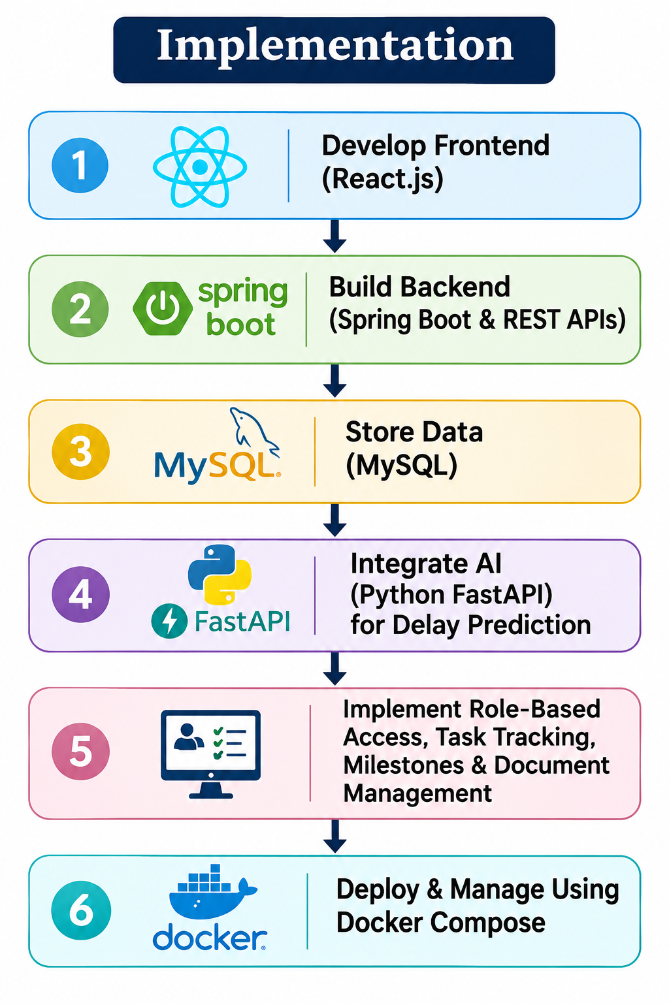
IMPLEMENTATION
Implementation
Developed the frontend using React to provide an interactive and user-friendly interface.
Implemented backend services using Spring Boot to handle authentication, project management, tasks, milestones, and user roles.
Used MySQL to store user details, project information, tasks, milestones, and prediction records.
Integrated a Python FastAPI service to perform AI-based project delay risk prediction.
Implemented secure document upload and download using persistent file storage.
Used Docker Compose to run and manage the application services.

Slide 8
TECHNOLOGY STACK
Layer | Technology
Frontend | React.js
Backend | Java, Spring Boot
Database | MySQL
AI/ML Service | Python, FastAPI
API Communication | REST APIs
Document Storage | Persistent Docker Volume
Deployment | Docker, Docker Compose

Slide 9
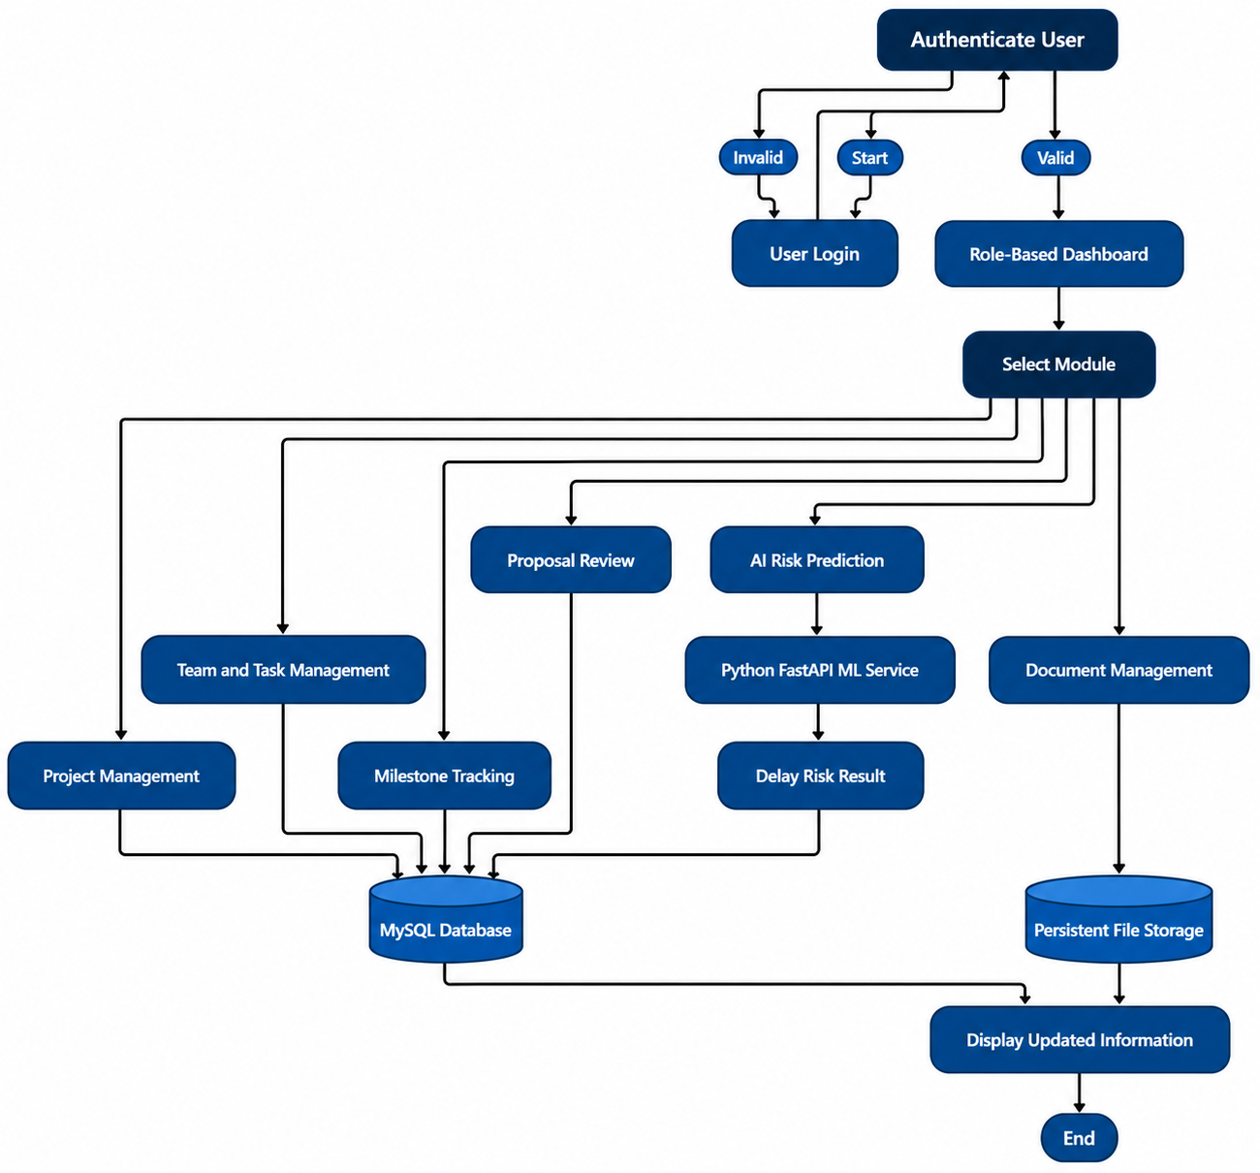
SYSTEM FLOW

Slide 10
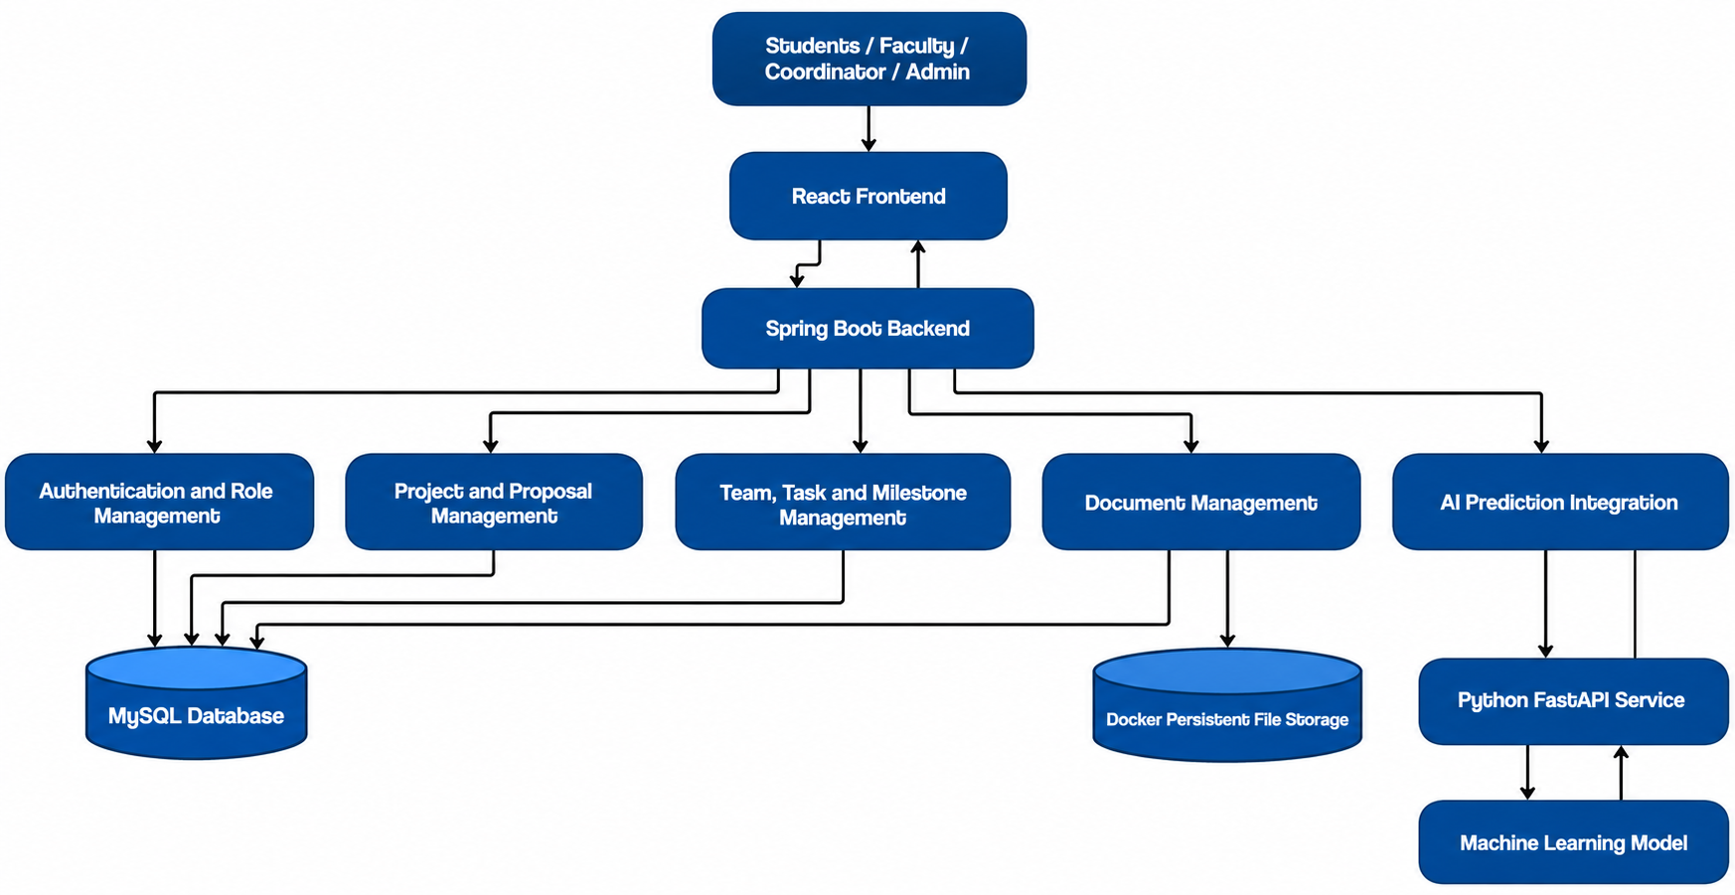
SYSTEM ARCHITECTURE

Slide 11
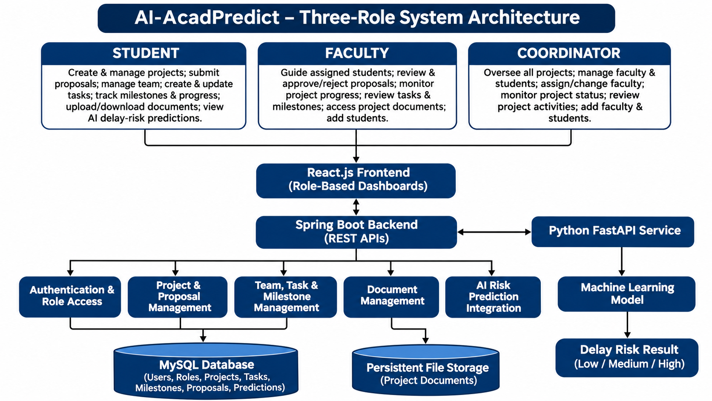
USERS ROLES

Slide 12
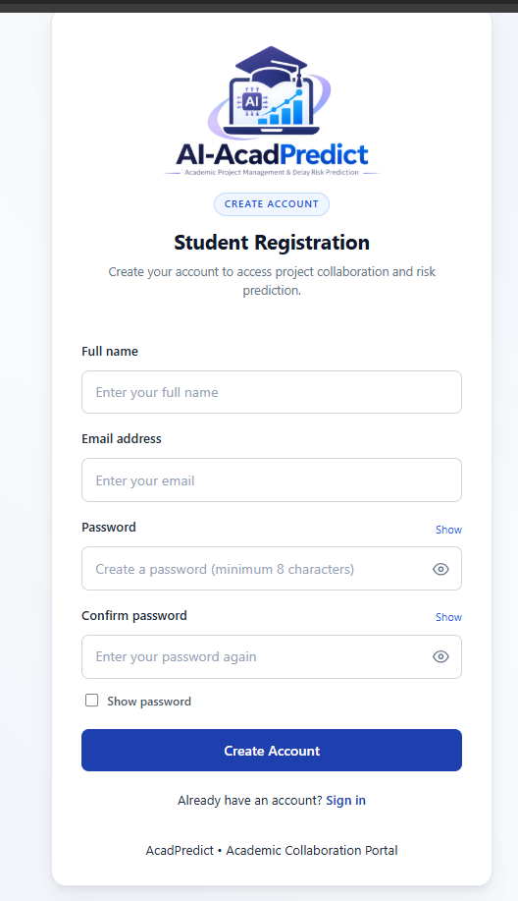
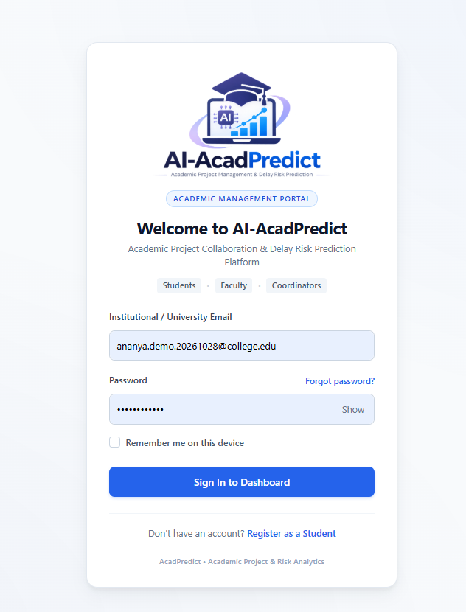
RESULTS

Slide 13
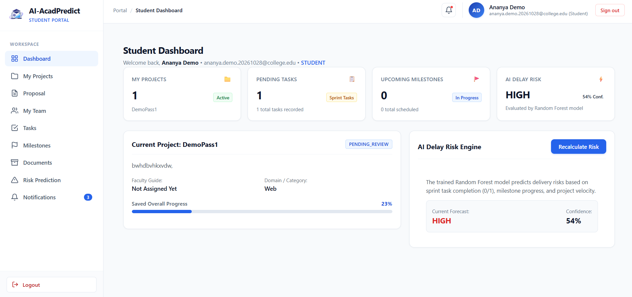
RESULTS

Slide 14
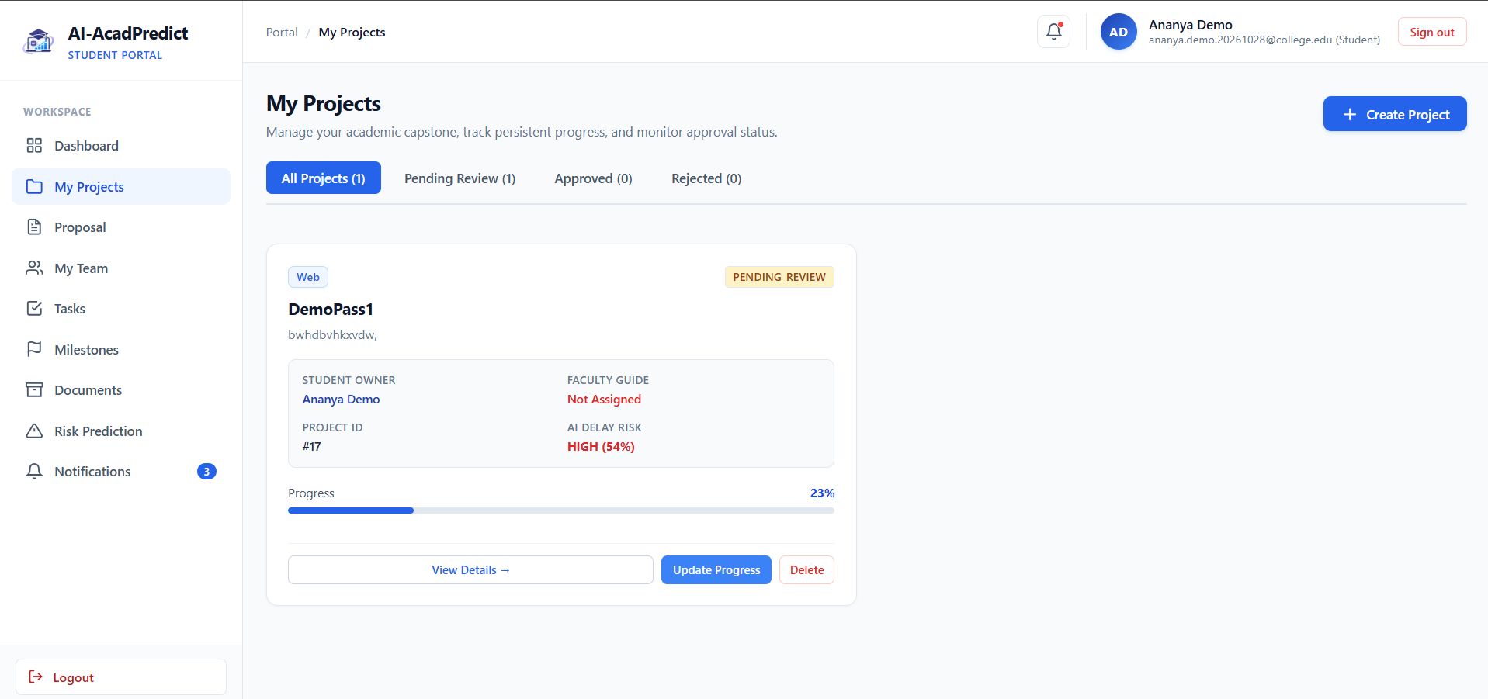
RESULTS

Slide 15
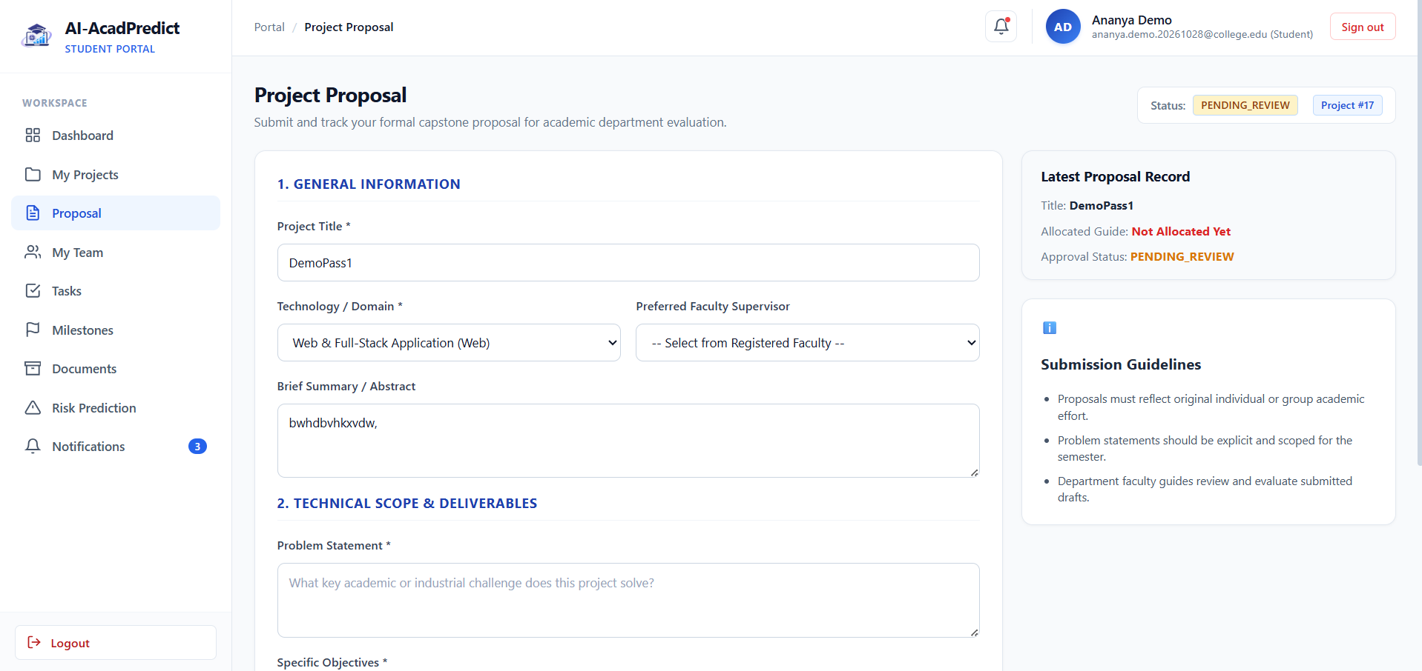
RESULTS

Slide 16
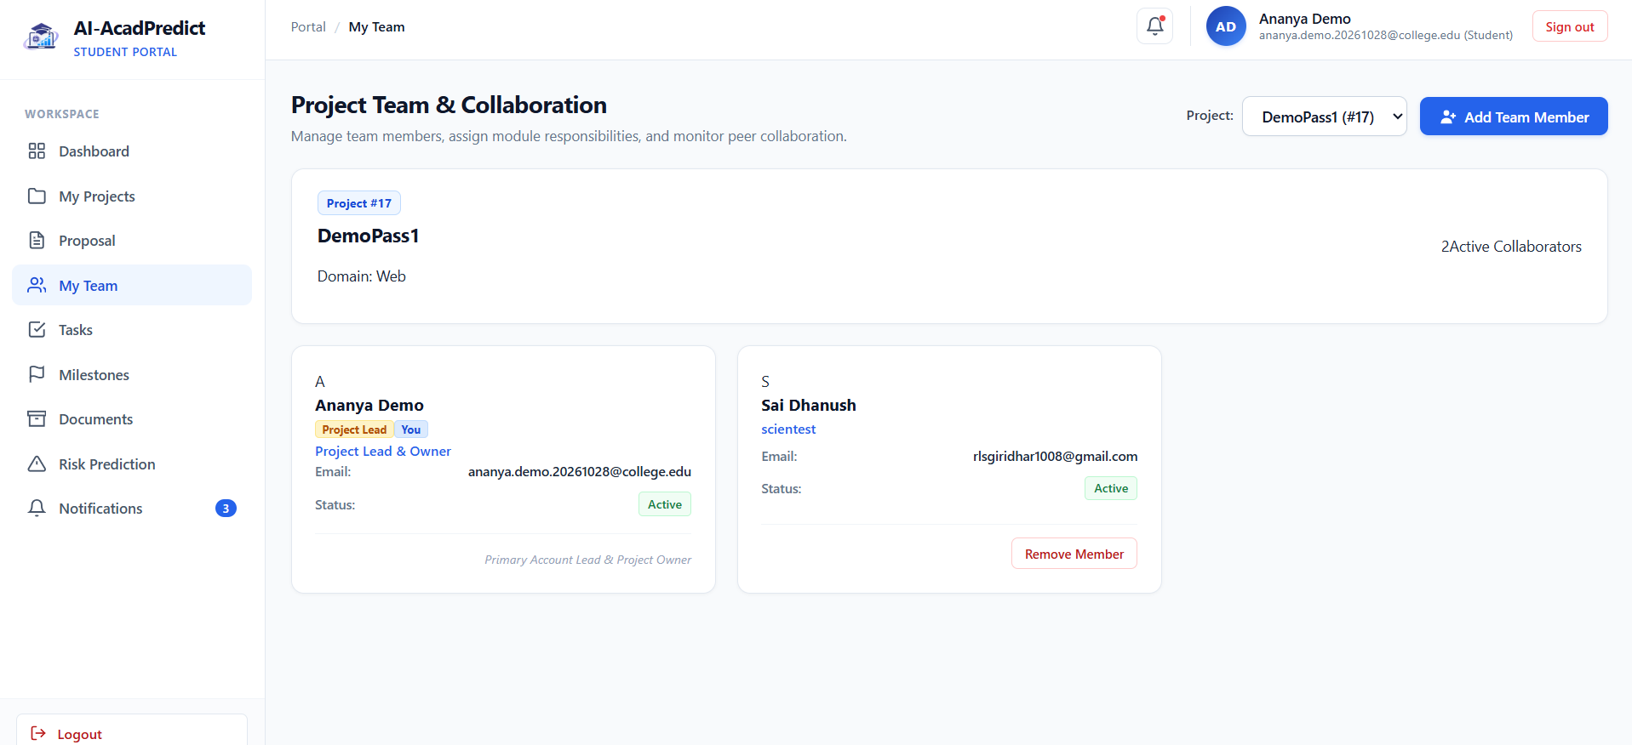
RESULTS

Slide 17
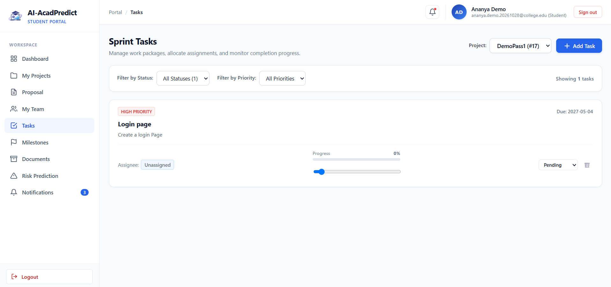
RESULTS

Slide 18
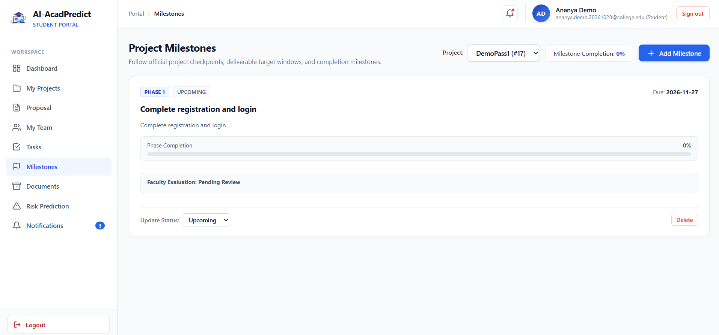
RESULTS

Slide 19
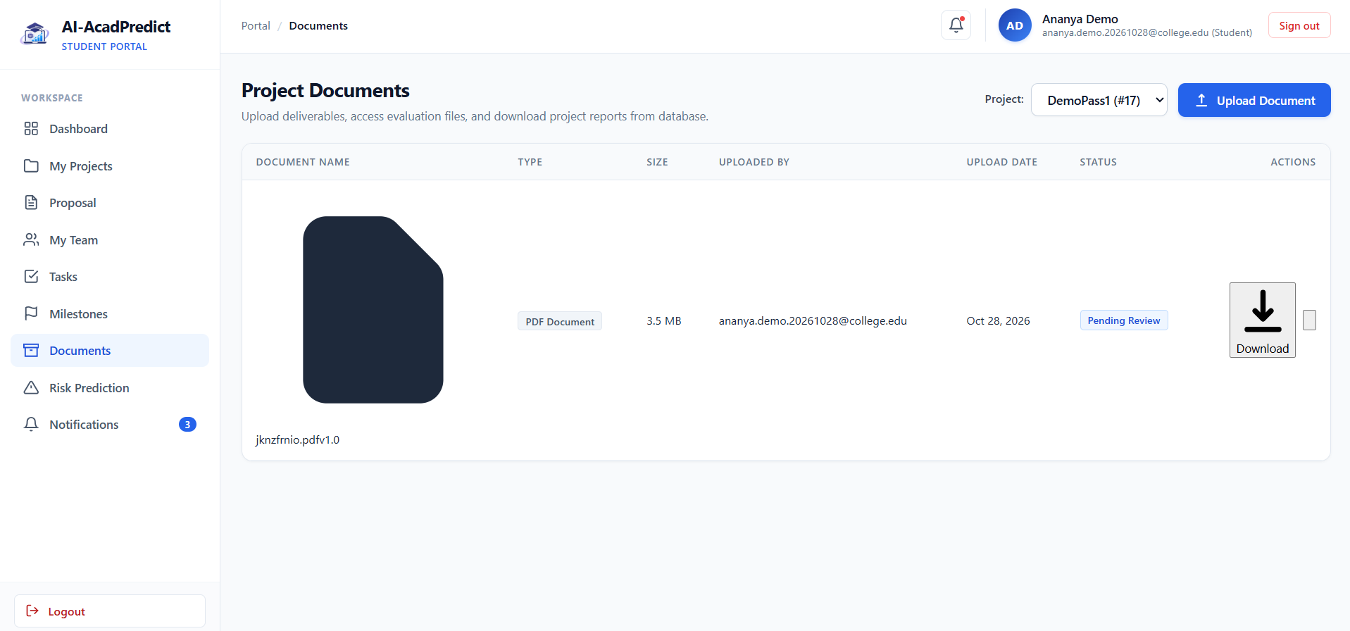
RESULTS

Slide 20
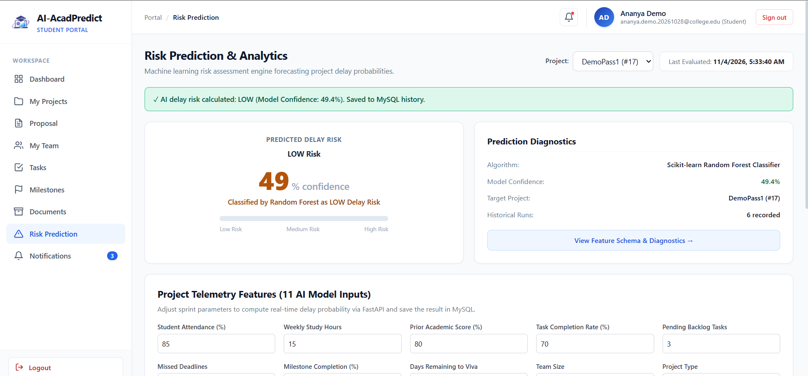
RESULTS

Slide 21
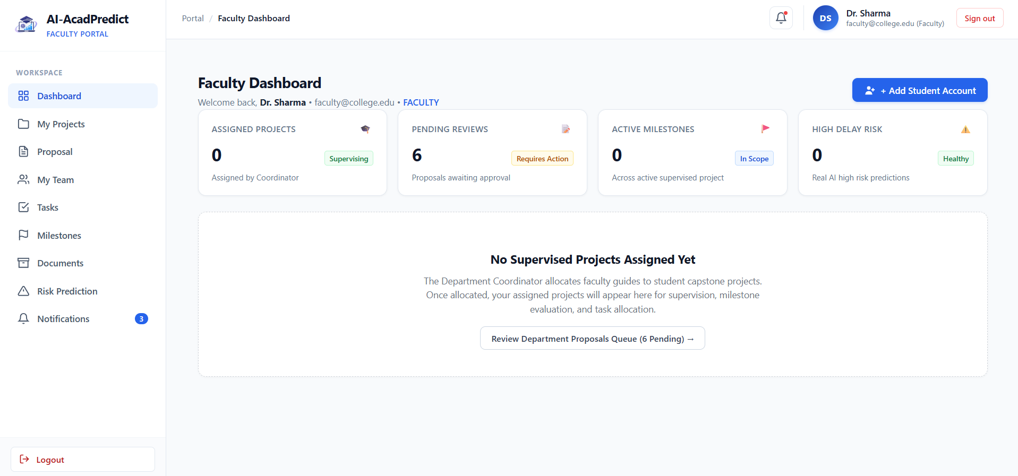
RESULTS

Slide 22

RESULTS

Slide 23
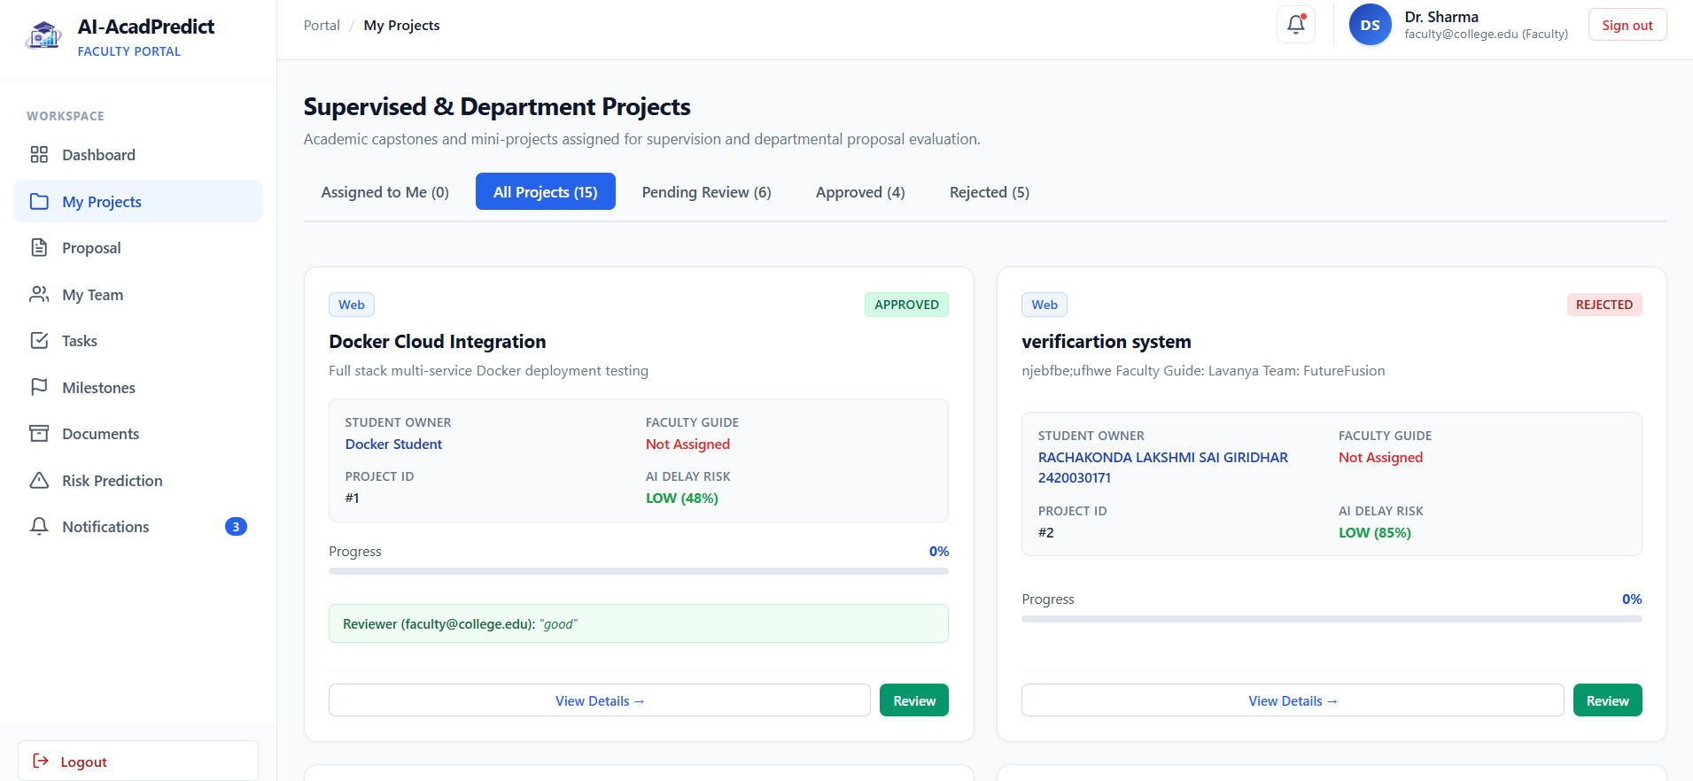
RESULTS

Slide 24
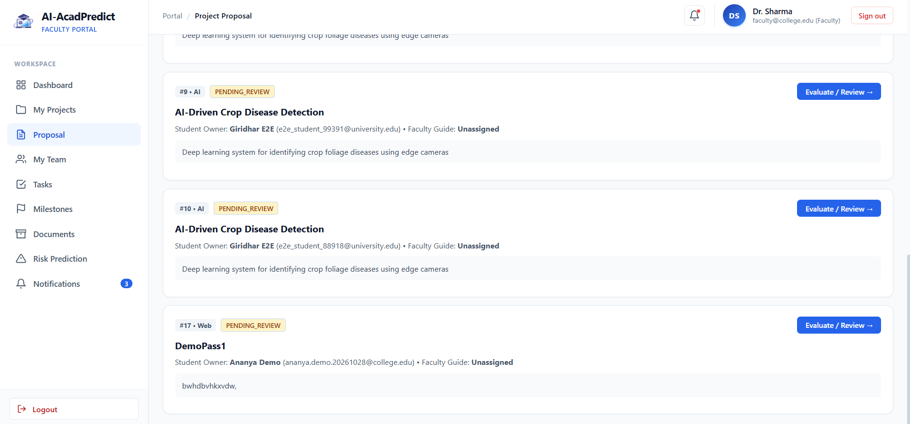
RESULTS

Slide 25
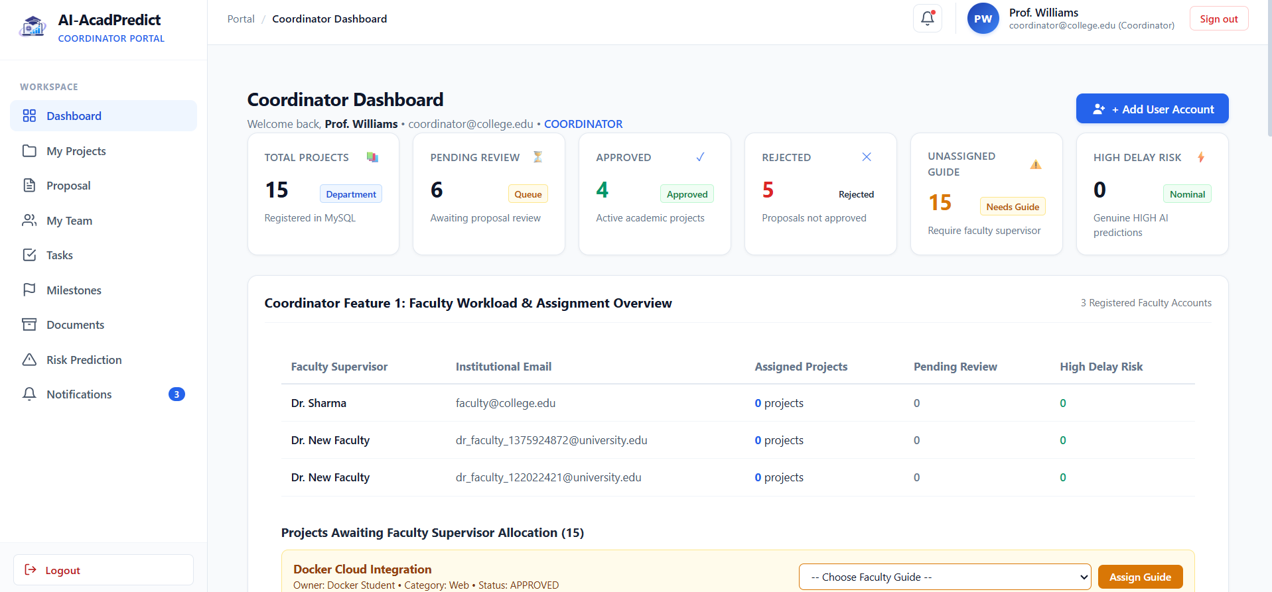
RESULTS

Slide 26
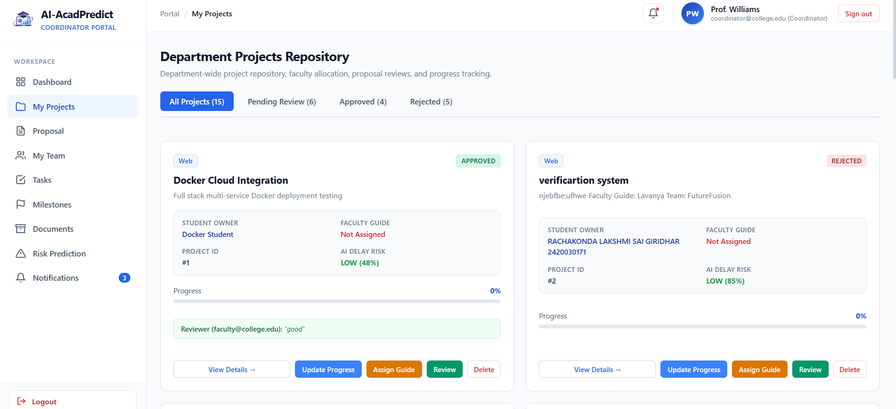
RESULTS

Slide 27
CONCLUSION
Conclusion
AI-AcadPredict provides a centralized platform for efficient academic project management.
It simplifies project planning, team collaboration, task assignment, milestone tracking, and document management.
Role-based dashboards help students, faculty, and coordinators manage their responsibilities effectively.
AI and Machine Learning help predict potential project delays and identify risks at an early stage.
The system improves project monitoring, coordination, and decision-making.
Overall, AI-AcadPredict aims to support better project execution and timely completion of academic projects.

Slide 28
Thankyou

